Slide 1
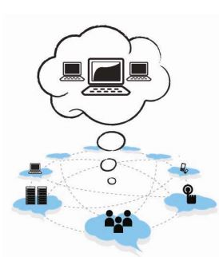
A
Seminar
On
Cloud Computing

Slide 2
What is Cloud Computing?
Distributed computing on internet Or delivery of computing service over the internet.
Eg: Yahoo!, GMail, Hotmail-
Instead of running an e-mail program on your computer, you log in to a Web e-mail account remotely. The software and storage for your account doesn't exist on your computer -- it's on the service's computer cloud.
Notes:
In computer networking , cloud computing is a phrase used to describe a variety of computing concepts. Distributed computing on internet.

Slide 3
History
Concept evolved in 1950(IBM) called RJE (Remote Job Entry Process).
In 2006 Amazon provided First public cloud AWS(Amazon Web Service).

Slide 4
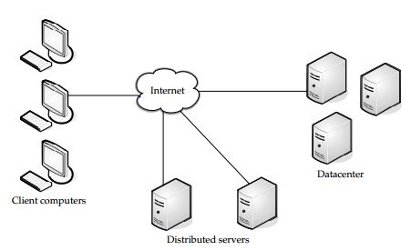
Cloud Components
It has three components
1.) Client computers
2.) Distributed Servers
3.) Datacenters

Slide 5
Clients
Clients are the device that the end user interact with cloud.
three types of clients:
1.) Mobile
2.) Thick
3.) Thin (Most Popular)

Slide 6
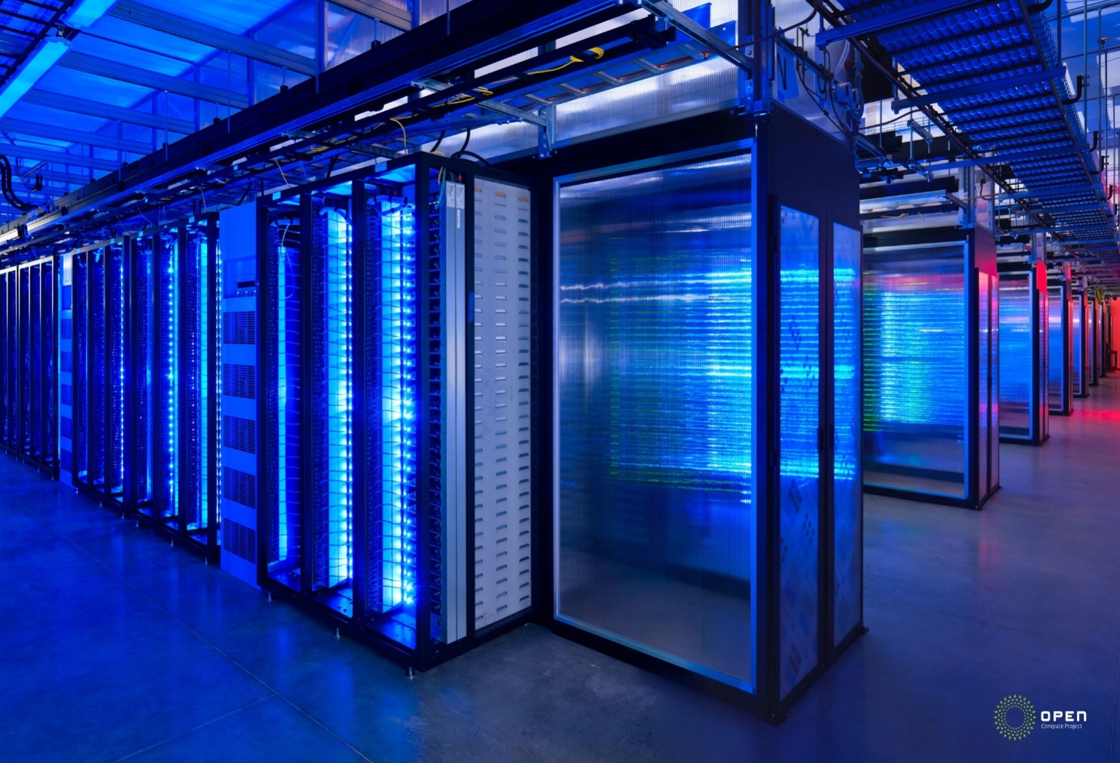
Datacenter
It is collection of servers where application is placed and is accessed via internet.

Slide 7
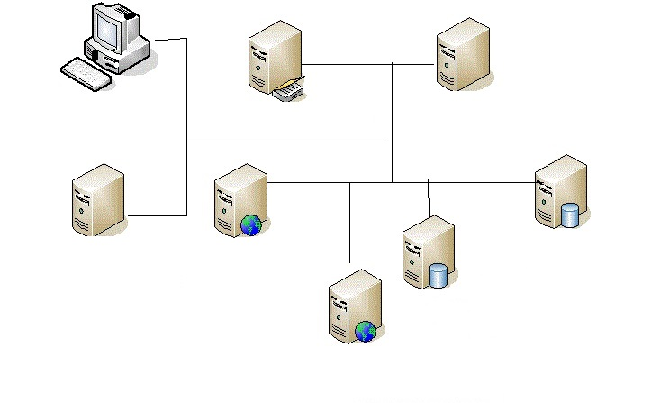
Distributed servers
Often servers are in geographically different places, but server acts as if they are working next to each other.

Slide 8
Central Server
It Administers the system such as monitoring traffic, client demands to ensure everything runs smoothly.
It uses a special type of software called Middleware.
Middleware allow computer to communicate each other.

Slide 9
Service Models
SaaS(Software as a service): Required software, Operating system & network is provided.
PaaS(Platform as service): Operating system and network is provided.
IaaS(Infrastructure as a service): just Network is provided.

Slide 10
Deployment of Cloud Service
Public Cloud
Private Cloud
Community Cloud
Hybrid Cloud(Combined Cloud)

Slide 11
Why cloud service is popular?
Reduce the complexity of networks.
Do not have to buy software licenses.
Customization.
Cloud providers that have specialized in a particular area (such as e-mail) can bring advanced services that a single company might not be able to afford or develop.
scalability, reliability, and efficiency.
Info. at cloud are not easily lost.
Notes:
Scalability means Unlimited processes and storage capacity.

Slide 12
Application
Social Networking sites.
E-mail sites.
Search Engines.
Many more services OVER THE INTERNET.

Slide 13
Thank You
For Your Attention…

